Slide 1
6.강 Deep Learning

Slide 2
Contents
Continuous State Space
Neural Network
Pytorch

Slide 3

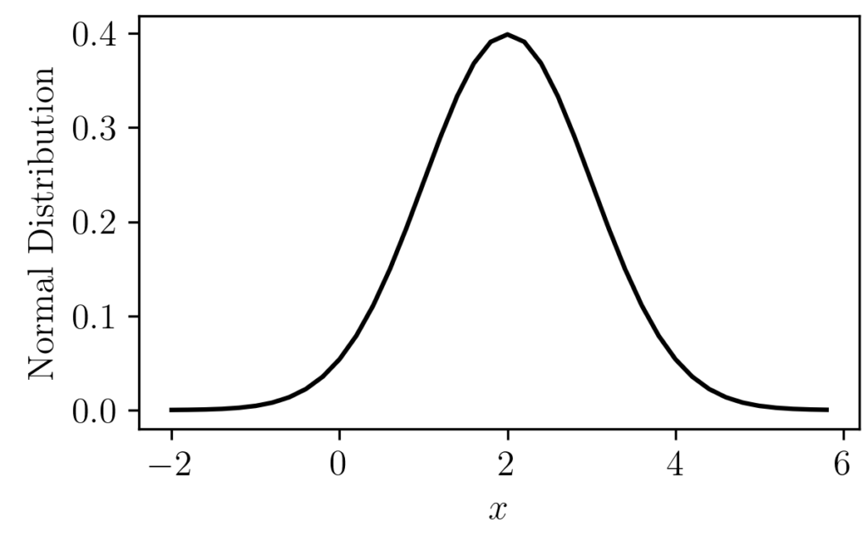
Continuous state spaces
V(s)
s

Slide 4
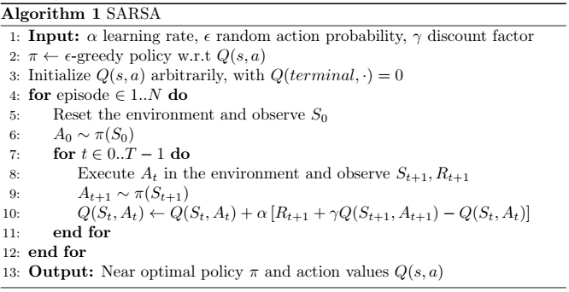
Continuous state spaces
Tabular methods
Infinite states:
[-10,10]
An entry Q(s, a) per state
We would need infinite memory

Slide 5
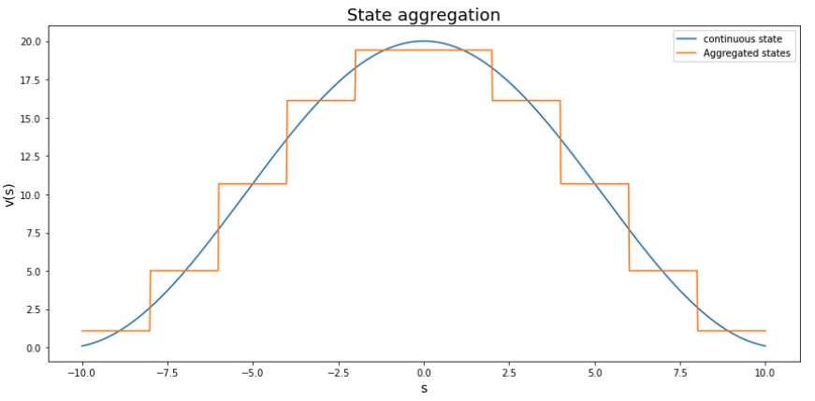
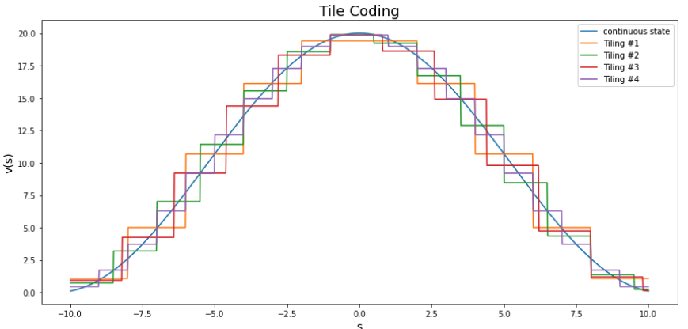
Continuous state spaces
The solution is, either transform the states to convert the continuous state space into a discrete state space, or use other algorithms
State aggregation | Tile coding

Slide 6
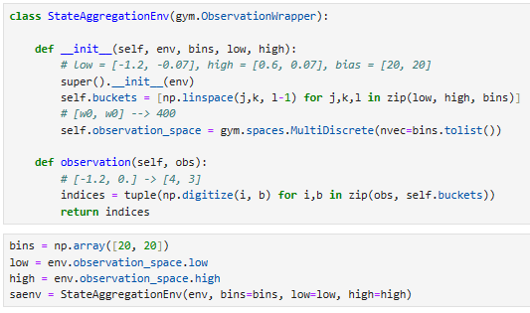
Continuous state spaces

Slide 7
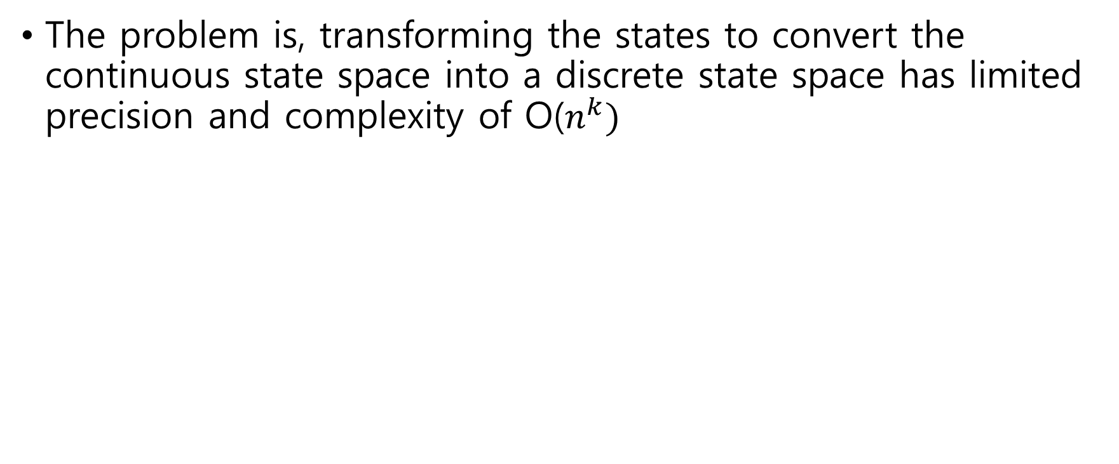
Disadvantages of transforming
The problem is, transforming the states to convert the continuous state space into a discrete state space has limited precision and complexity of O($n^{k})$

Slide 8
Neural Network

Slide 9
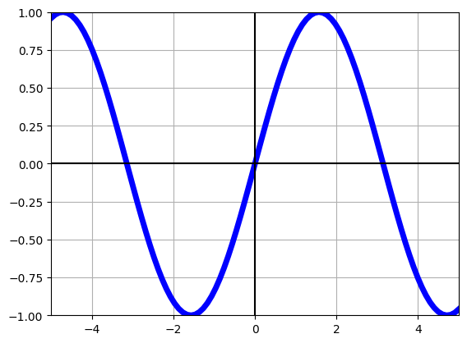
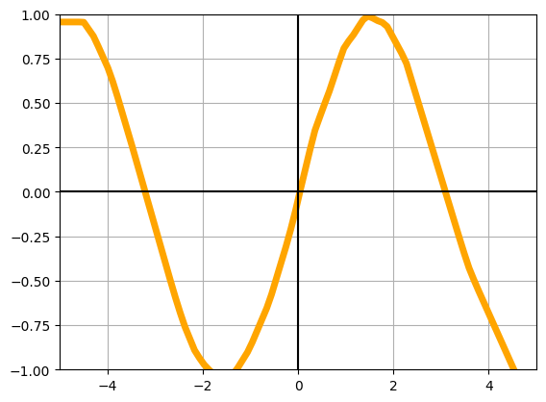
Function approximators
V(s)
V(s)
s
s

Slide 10
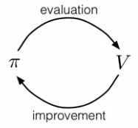
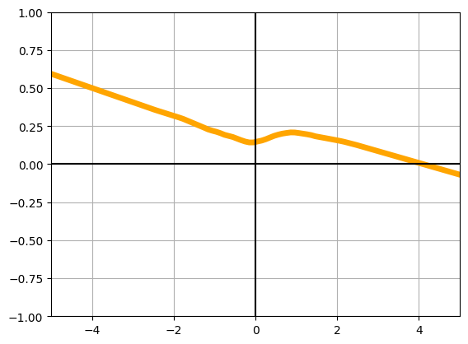
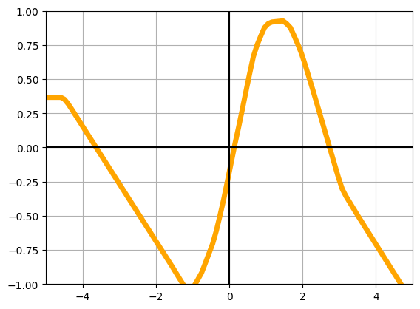
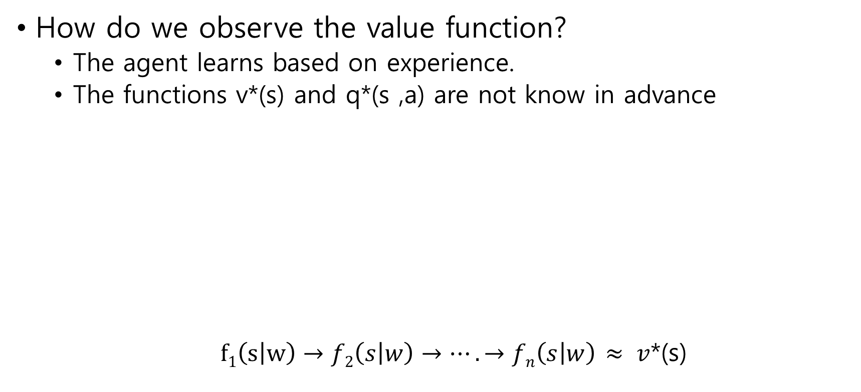
Function approximators
How do we observe the value function?
The agent learns based on experience.
The functions v*(s) and q*(s ,a) are not know in advance
$f1\left(s | w\right)→f2\left(s | w\right)→….→fn\left(s | w\right)$ $≈ v$*(s)
Policy
V(s)
Policy
s
s
s

Slide 11
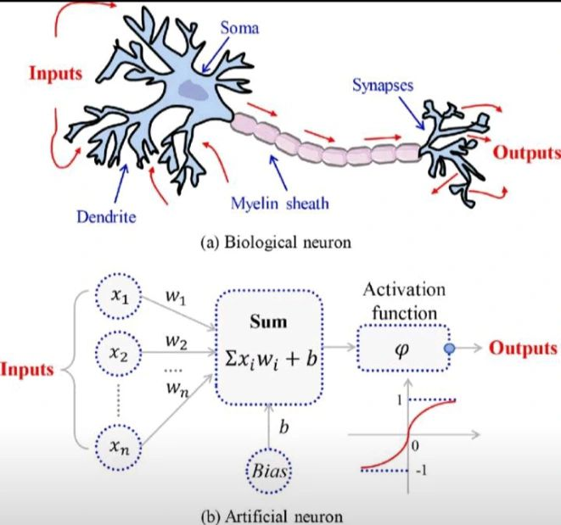
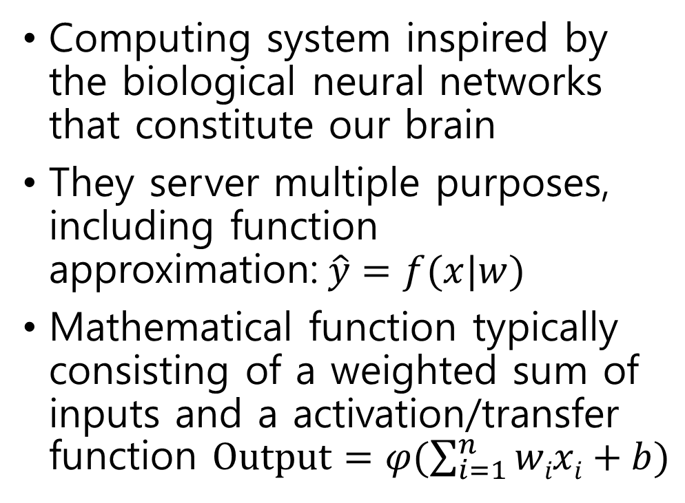
Neural Networks
Computing system inspired by the biological neural networks that constitute our brain
They server multiple purposes, including function approximation:$\hat{y}=f(x|w)$
Mathematical function typically consisting of a weighted sum of inputs and a activation/transfer function $Output=φ(\sum_{i=1}^{n}{wixi}+b)$

Slide 12
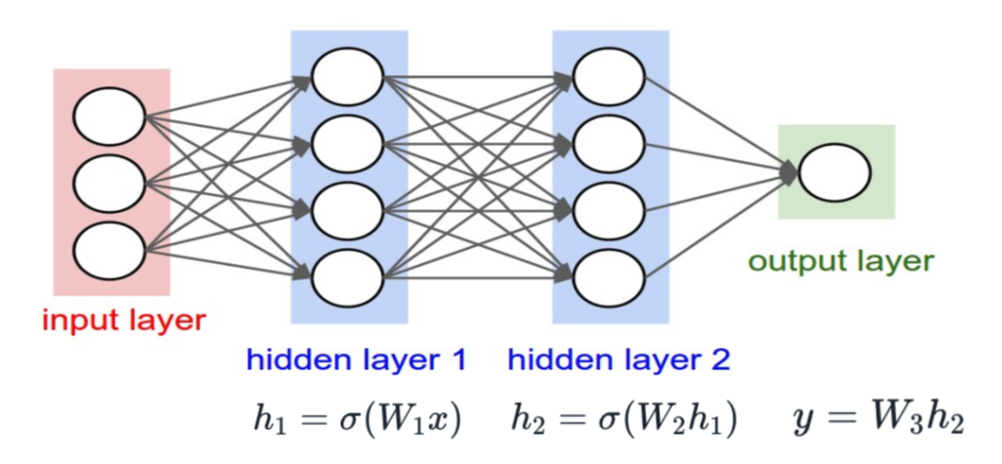
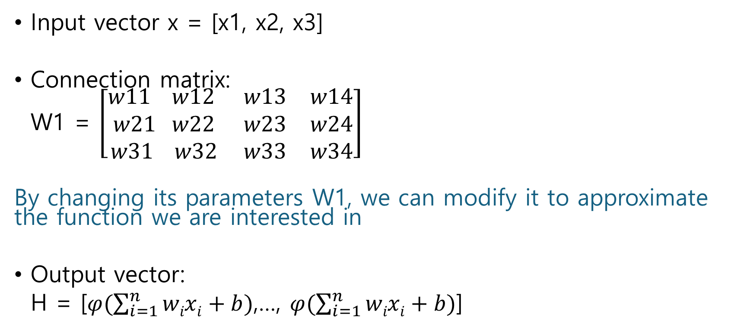
Neural networks
Input vector x = [x1, x2, x3]
Connection matrix:
W1 = $\left[\begin{matrix}w11 w12 & w13 & w14 \\ w21 w22 & w23 & w24 \\ w31 w32 & w33 & w34\end{matrix}\right]$
By changing its parameters W1, we can modify it to approximate the function we are interested in
Output vector:
H = [$φ(\sum_{i=1}^{n}{wixi}+b)$,…, $φ(\sum_{i=1}^{n}{wixi}+b)$]

Slide 13
Neural Networks
Networks that do not have cycles are known as feedforward NN. Signals always propagate forward
The neuron receives inputs, process & aggregate those inputs, and either inhibits or amplifies before passing the signal to the next layer

Slide 14
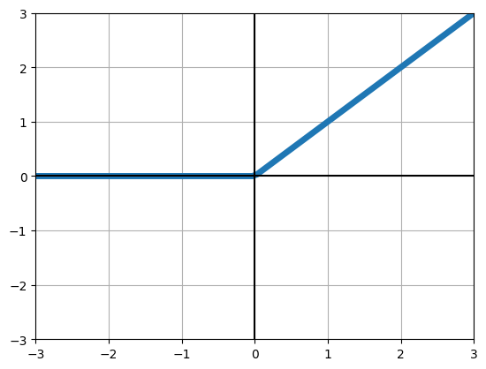
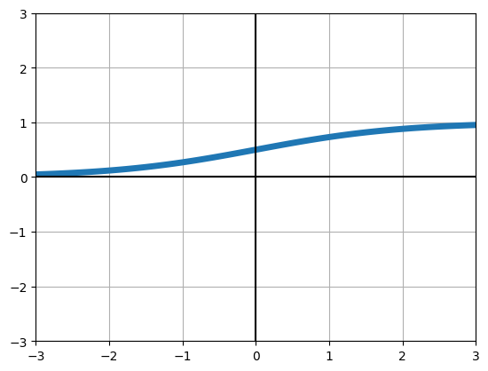
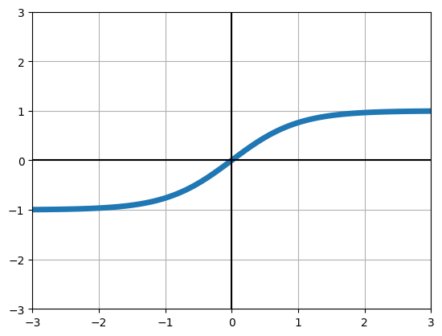



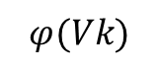
Neural networks
Activation functions
Relu()
Sigmoid()
Tanh()
$$φ(Vk)$$
$$Vk$$
$$Vk$$
$$Vk$$

Slide 15
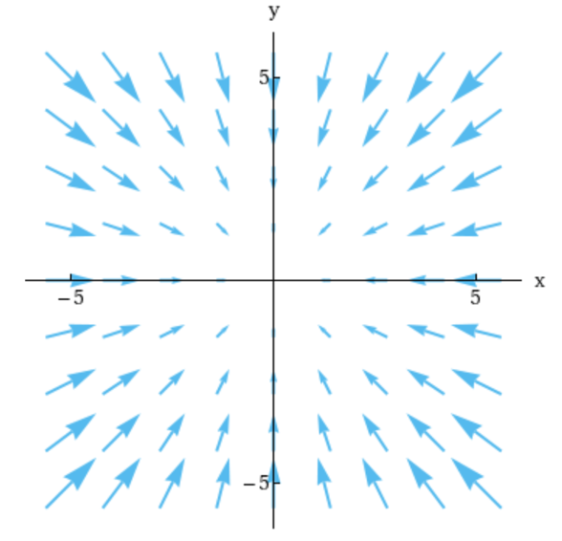
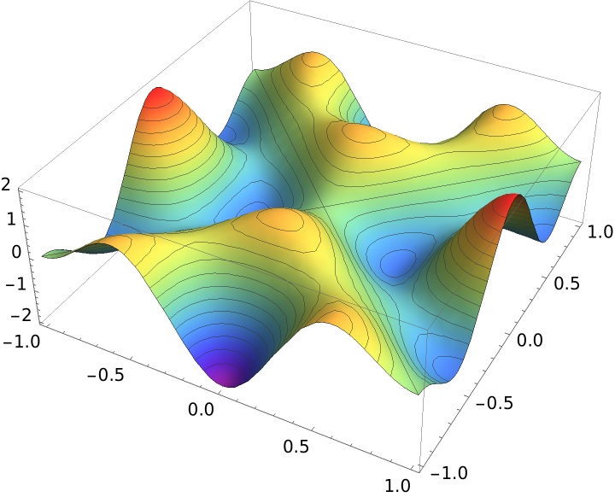
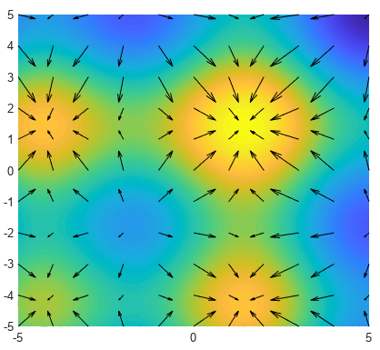
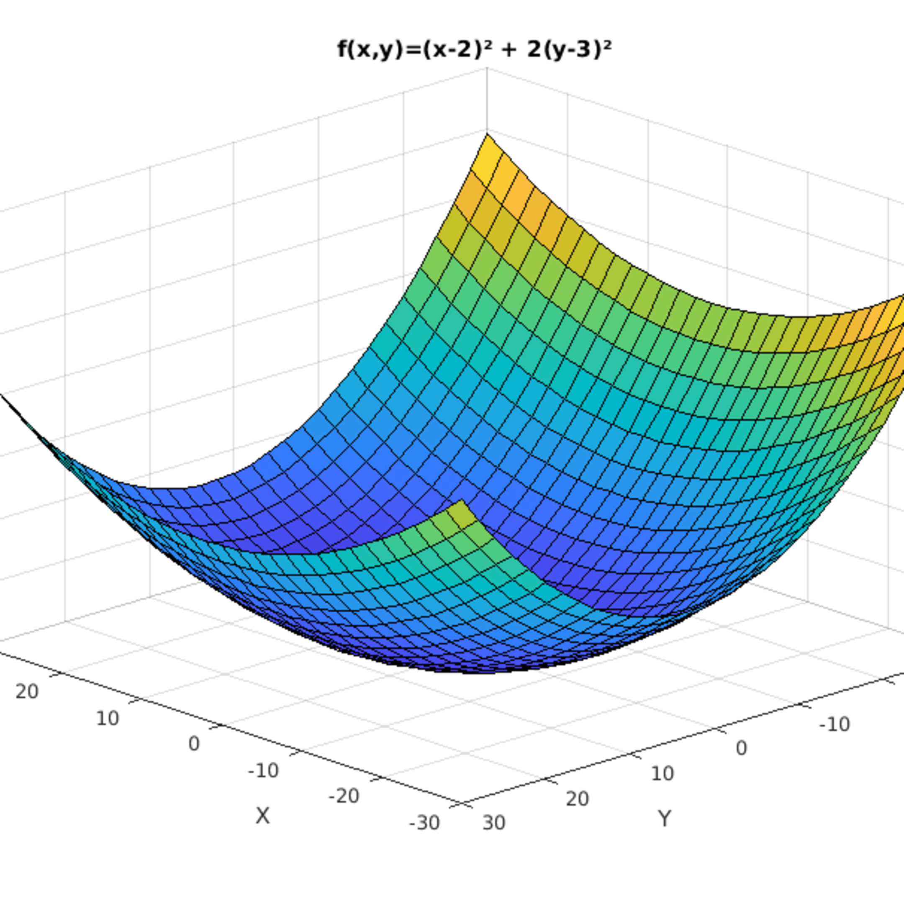
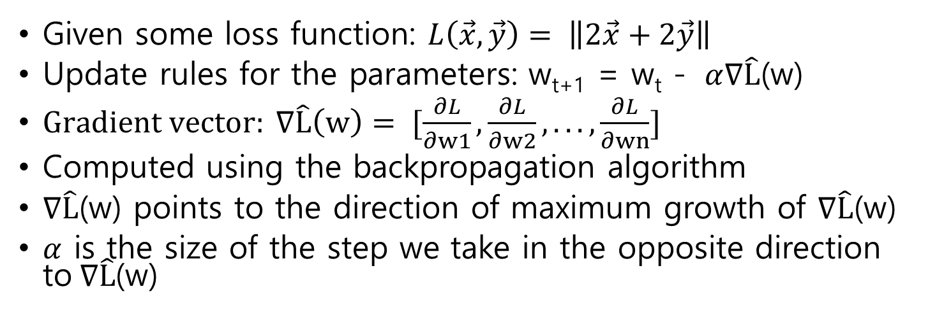
Gradient Descent
Given some loss function: $L\left(\vec{x},\vec{y}\right)= \left\|2\vec{x}+2\vec{y}\right\|$
Update rules for the parameters: w_{t+1} = w_{t} - $α∇\hat{L}$(w)
$Gradient vector: ∇\hat{L}\left(w\right)= [\frac{∂L}{∂w1},\frac{∂L}{∂w2},...,\frac{∂L}{∂wn}]$
Computed using the backpropagation algorithm
$∇\hat{L}$(w) points to the direction of maximum growth of $∇\hat{L}$(w)
$α$ is the size of the step we take in the opposite direction to$∇\hat{L}$(w)

Slide 16
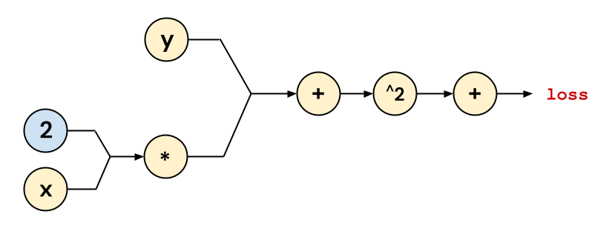
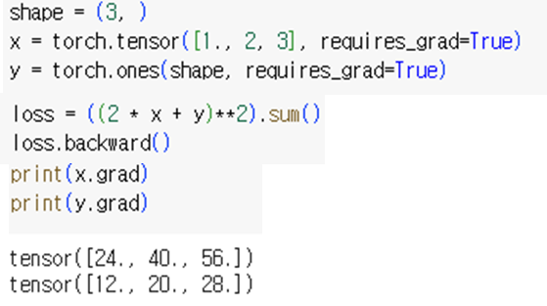
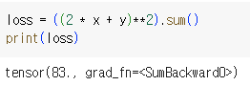
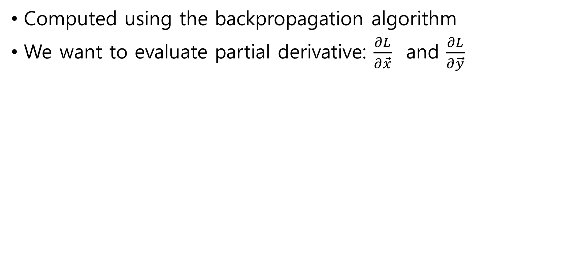
Backpropagation
Computed using the backpropagation algorithm
We want to evaluate partial derivative: $\frac{∂L}{∂\vec{x}}$ and $\frac{∂L}{∂\vec{y}}$

Slide 17
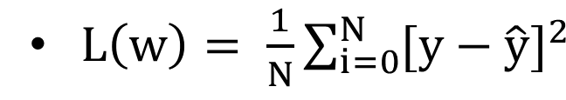
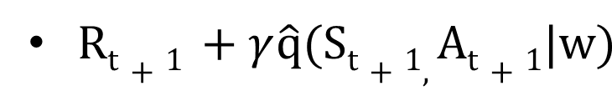
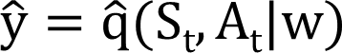
Cost function
Mean squared error:
For our neural network to estimate q(s, a) as well as possible, we will minimize the observed squared errors
Target value: Estimated value:

Slide 18
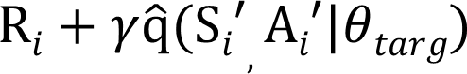
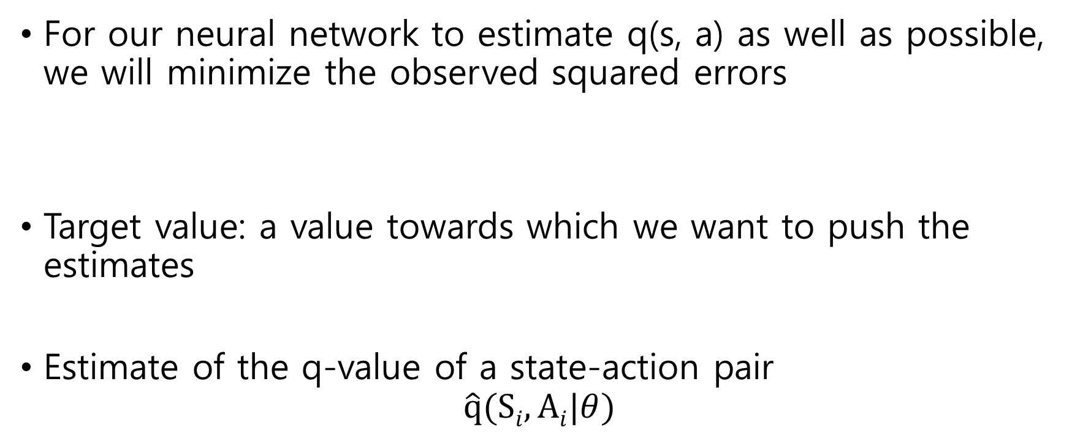
Neural network optimization
For our neural network to estimate q(s, a) as well as possible, we will minimize the observed squared errors
Target value: a value towards which we want to push the estimates
Estimate of the q-value of a state-action pair
$$\hat{q}(Si, Ai|θ)$$

Slide 19
Pytorch
Pictures from Stanford’s CS231n
Pictures from Berkeley CS285

Slide 20
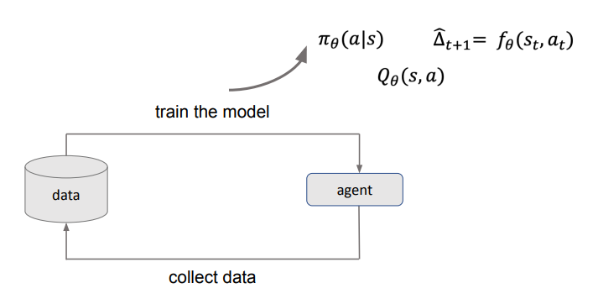
Train an agent to perform useful tasks

Slide 21
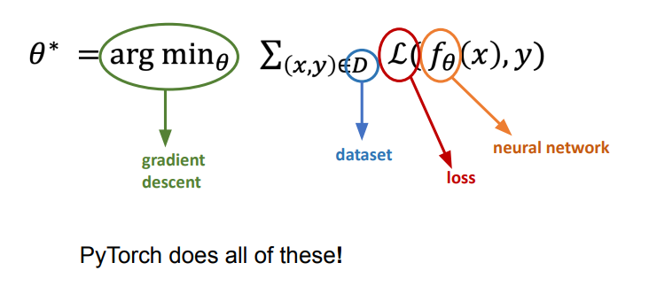
How do train a model

Slide 22
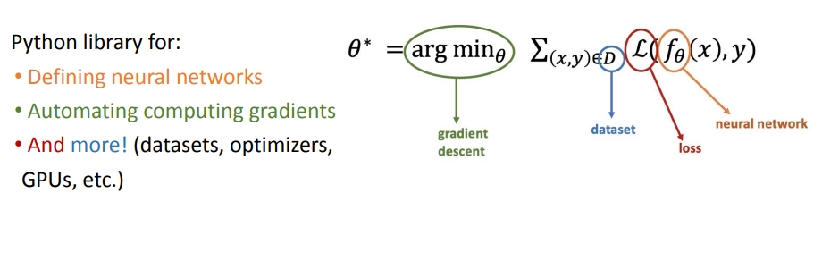
What is Pytorch

Slide 23
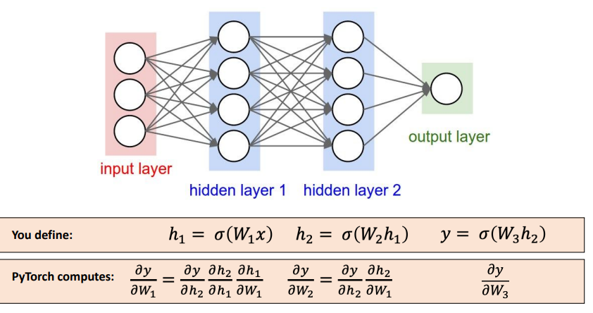
How does Pytorch works?

Slide 24
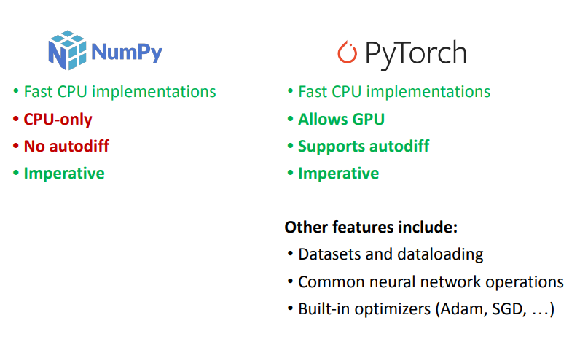
Numpy & PyTorch

Slide 25
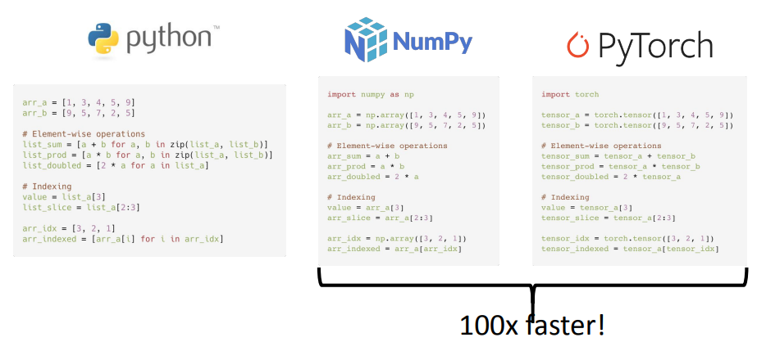
The Basics

Slide 26
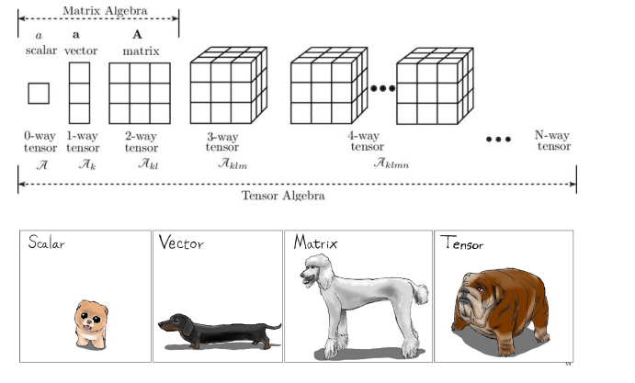
Multidimensional Array

Slide 27
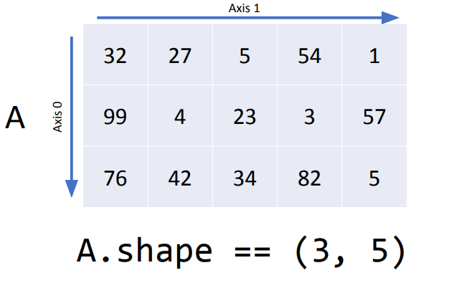
Multidimensional Indexing

Slide 28
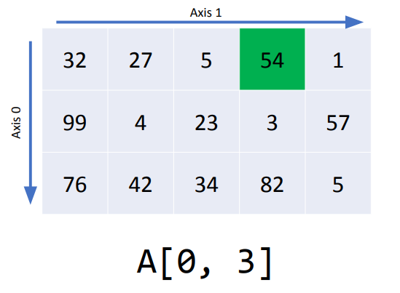
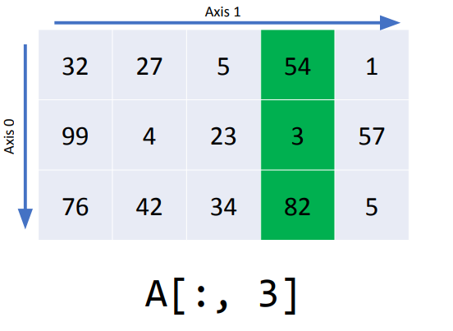
Multidimensional Indexing

Slide 29
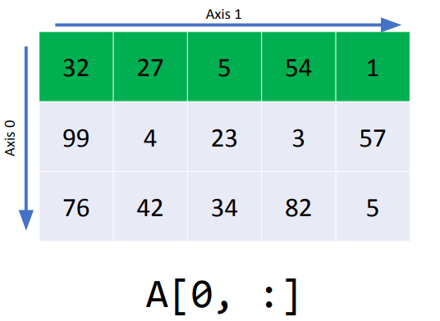
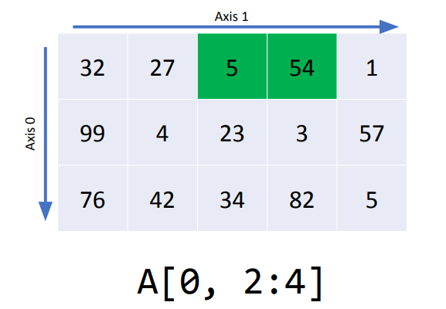
Multidimensional Indexing

Slide 30
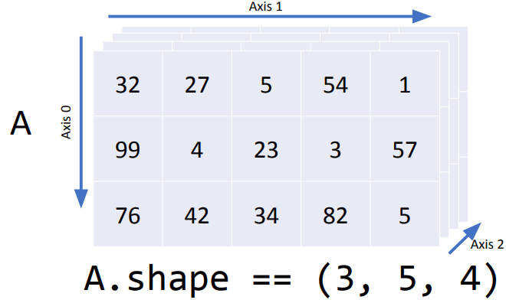
Multidimensional Indexing

Slide 31
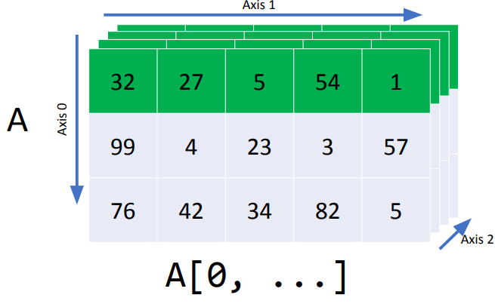
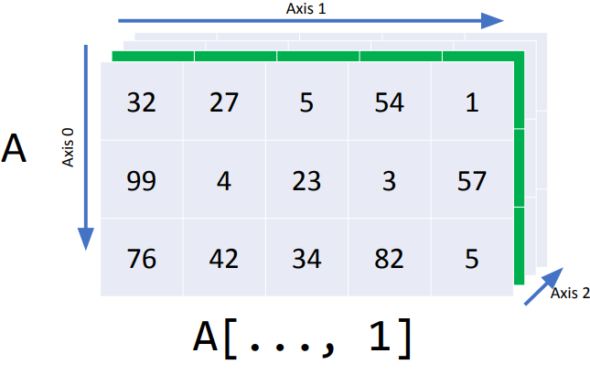
Multidimensional Indexing

Slide 32
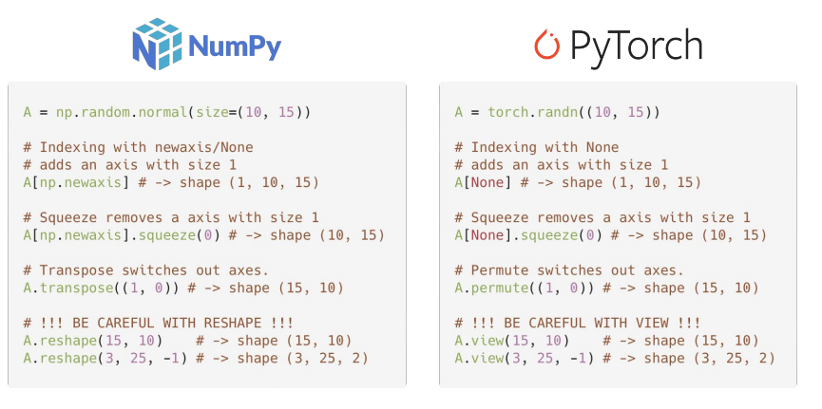
Shape Operations

Slide 33

Device Management

Slide 34

Device Management

Slide 35

Computing Gradients

Slide 36

Computing Gradients

Slide 37

Training Loop

Slide 38

Converting Numpy / PyTorch

Slide 39

Custom networks
nn.Module represents the building blocks of a computation graph.
For example, in typical pytorch code, each convolution block is its own module, each fully connected block is a module, and the whole network itself is also a module.
Modules can contain modules within them. All the classes inside of `torch.nn` are instances `nn.Modules`.

Slide 40
Custom networks

Slide 41

Torch Best Practices

Slide 42

Torch Best Practices

Slide 43
Let’s play with the code
http://bit.ly/cs285-pytorch-2023

